Slide 1
1 week course on teaching pupils with special educational needs
Porthsmouth 11 – 19 march 2017

Slide 2

kursanci

Slide 3
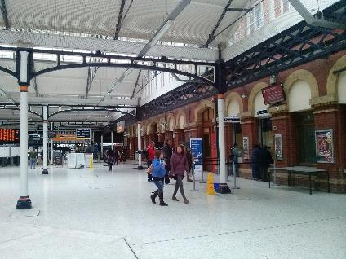
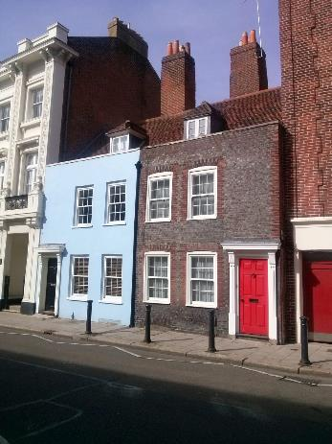
PORTSMOUTH

Slide 4
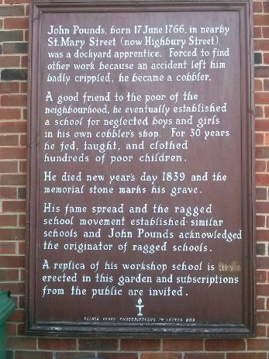
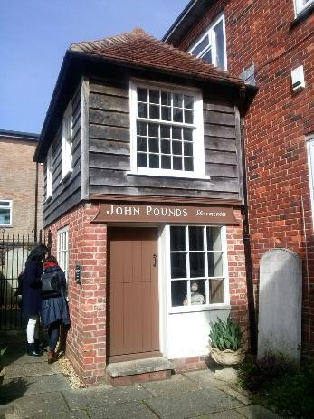
PORTSMOUTH

Slide 5
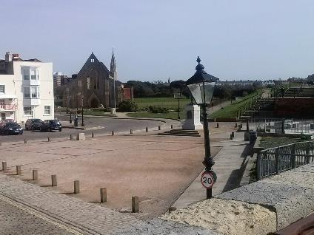
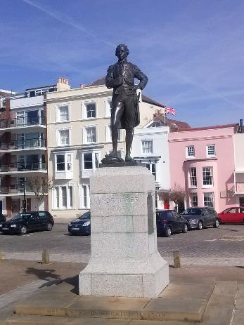
PORTSMOUTH

Slide 6
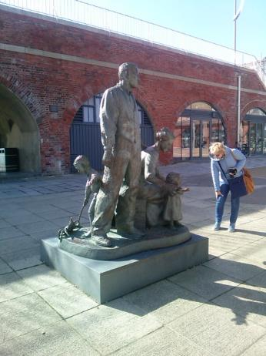
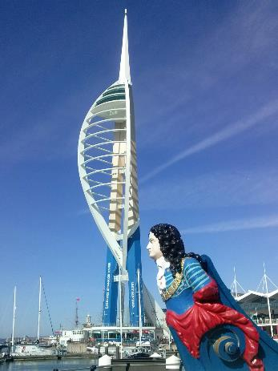
PORTSMOUTH

Slide 7
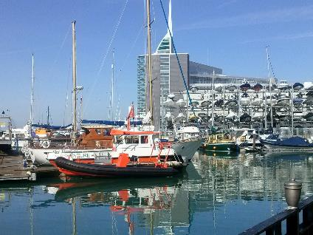
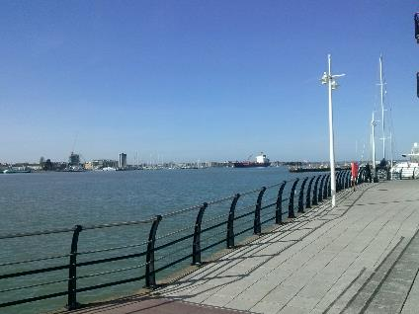
PORTSMOUTH

Slide 8
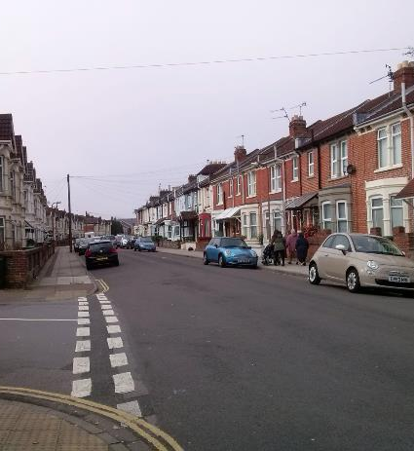
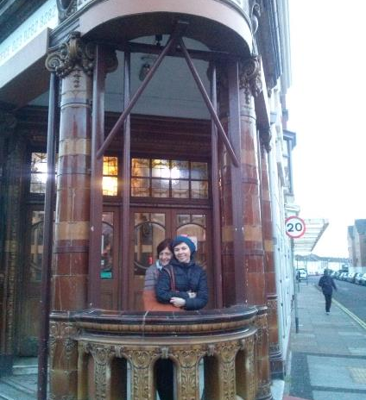
PORTSMOUTH

Slide 9
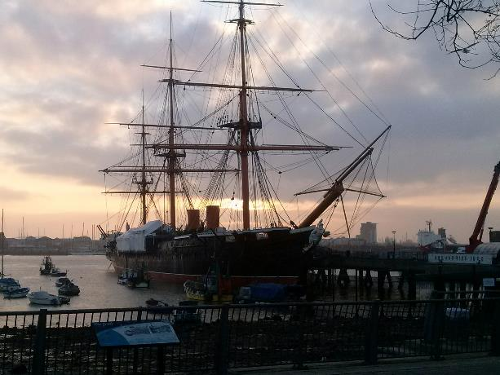
PORTSMOUTH

Slide 10

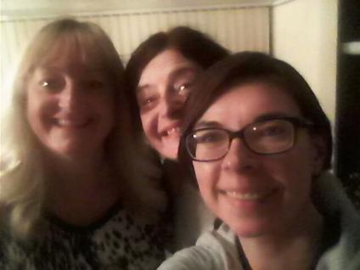
PORTSMOUTH

Slide 11
WYKŁADY
Wykład “Angielski System Edukacji”;
Wykład “Angielski System Edukacji a Specjalne Potrzeby Edukacyjne”:
Wczesne rozpoznanie (early identification)
Indywidualne podejście / plany behawioralne (indywidual education/behavioural plans)
Strategie postępowania (intervention strategies)
Znaczenie edukacji emocjonalnej? (importance of emotional literacy)
Władze lokalne – w znaczeniu organu prowadzącego (Local authority)
Znaczenie szkół specjalnych (the role of special schools)
Znaczenie edukacji włączającej (the importance of inclusion)
Wsparcie nauczania ?(Learning support)

Slide 12
wykłady
Wykład z Koordynatorem Ds. Specjalnych Potrzeb Edukacyjnych Z Arundel Court Primary (Special Educational Needs Coordinator - SENCO)
Organizowanie pracy zespołu nauczycielskiego
Learning support – zaj. Dodatkowe
Sposoby pracy – learning and teaching policy communication
Literacy and language policy
Behaviour management – praca nad zachowaniem
Współpraca z rodzicami

Slide 13
wykłady
Wykład “Learning Support For Dyslexic Pupils ”

Slide 14
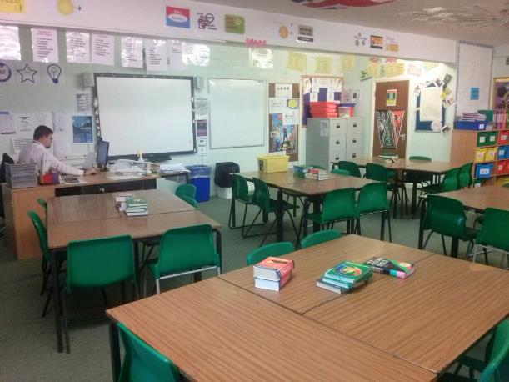
Secondary school

Slide 15
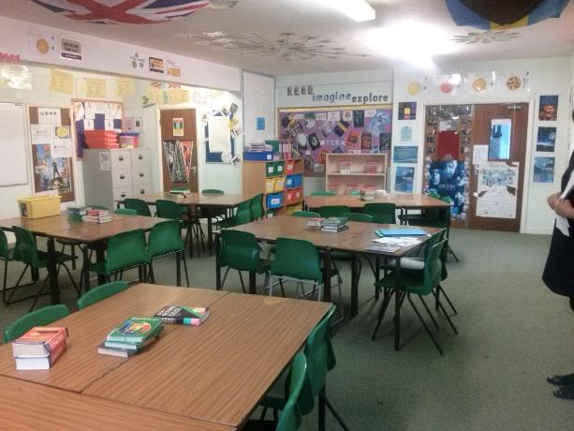
SECONDARY SCHOOL

Slide 16
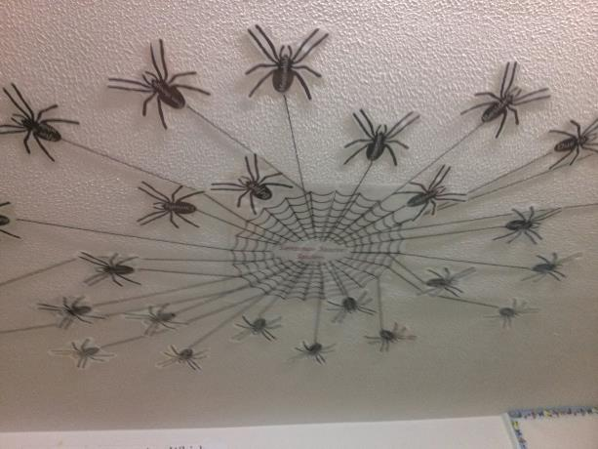
SECONDARY SCHOOL sentence spider starter

Slide 17
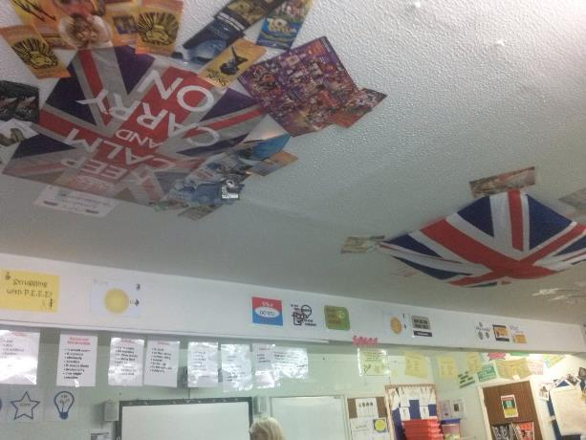
SECONDARY SCHOOL

Slide 18
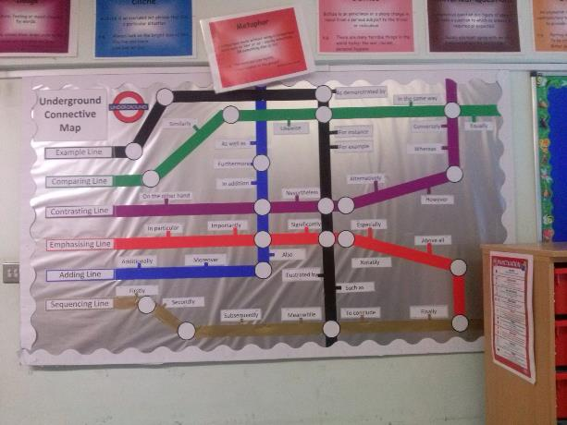
SECONDARY SCHOOL underground connective map

Slide 19
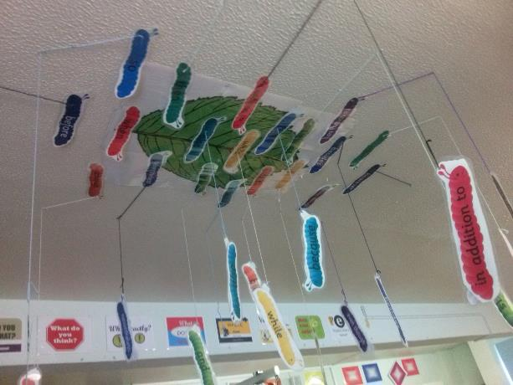
SECONDARY SCHOOL

Slide 20
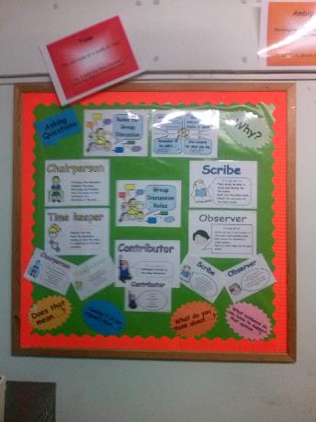
secondary school group discussion roles

Slide 21
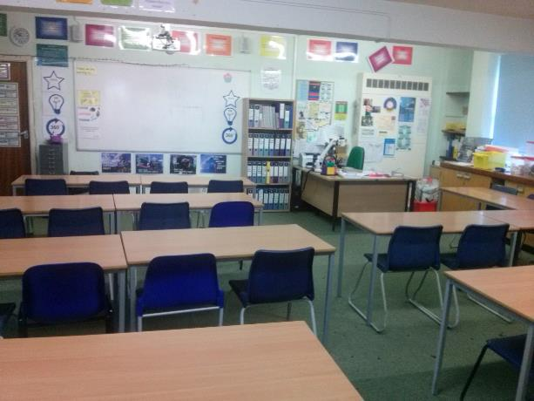
Secondary school matematyka

Slide 22
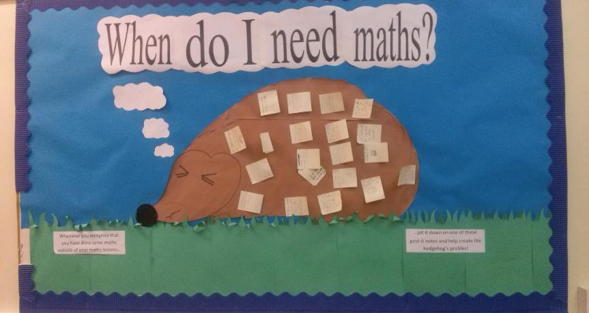
Secondary school

Slide 23
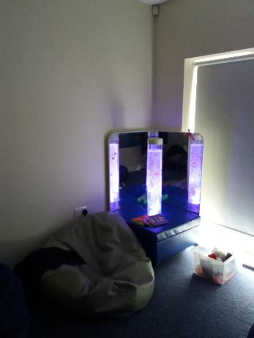
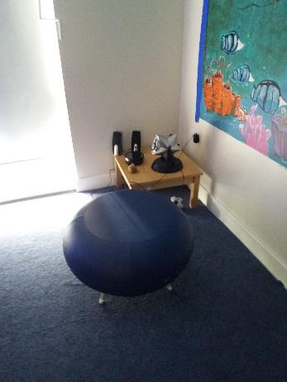

Slide 24
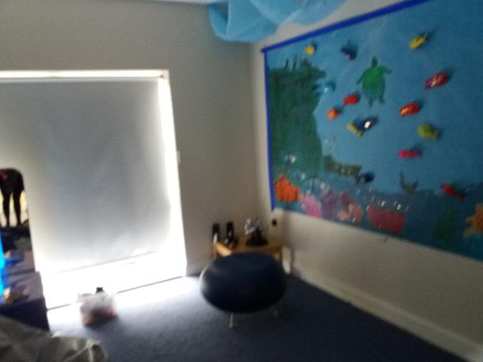

Slide 25
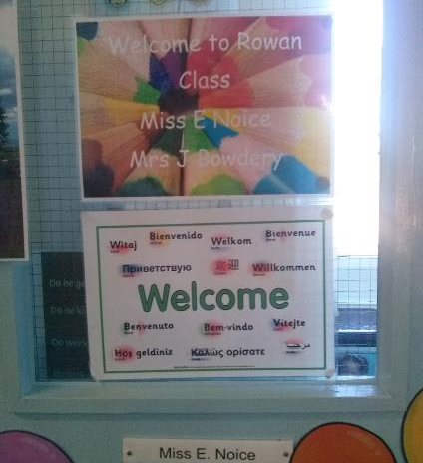
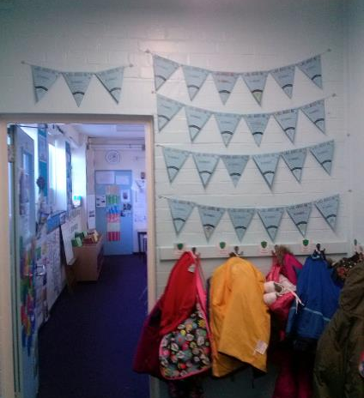
PRIMARY SCHOOL
Highbury Primary School, Nursery And Day Care

Slide 26
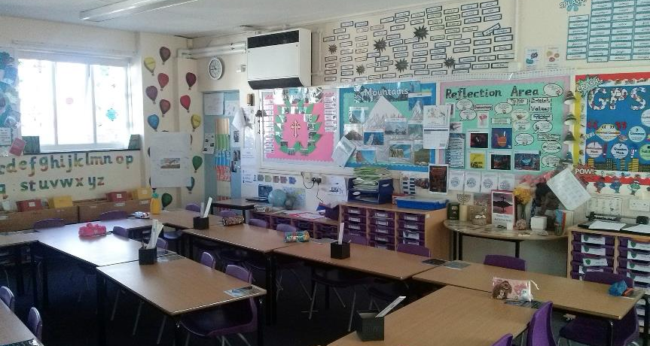
PRIMARY SCHOOL
Highbury Primary School, Nursery And Day Care

Slide 27
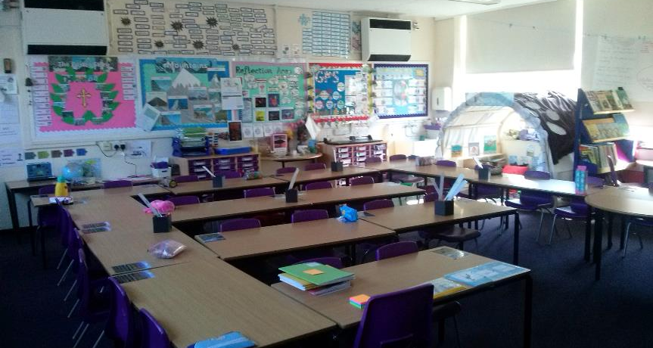
PRIMARY SCHOOL
Highbury Primary School, Nursery And Day Care

Slide 28
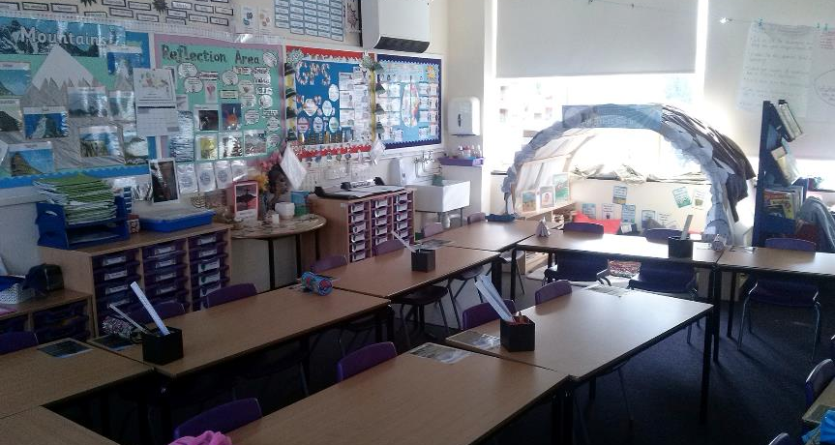
PRIMARY SCHOOL
Highbury Primary School, Nursery And Day Care

Slide 29
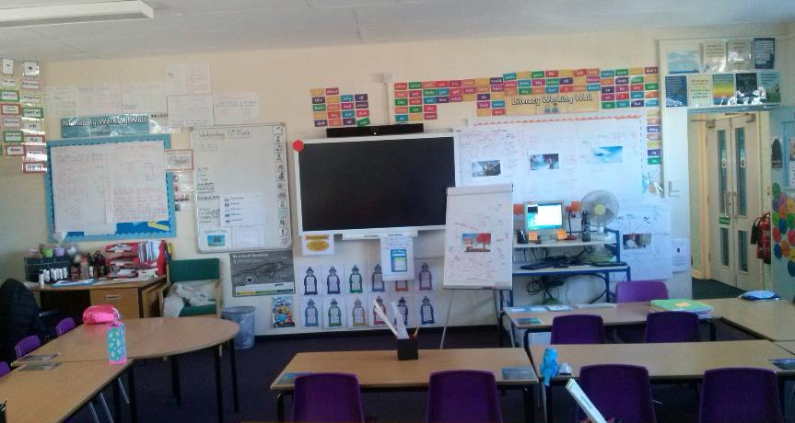
PRIMARY SCHOOL
Highbury Primary School, Nursery And Day Care

Slide 30
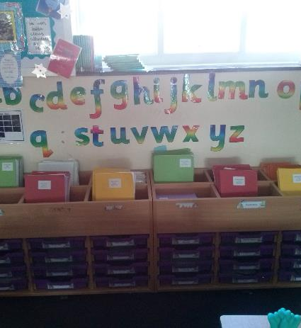
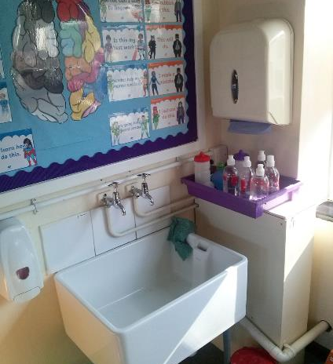
PRIMARY SCHOOL
Highbury Primary School, Nursery And Day Care

Slide 31
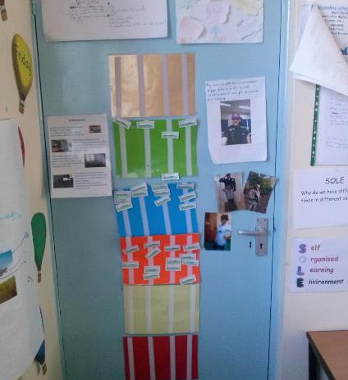
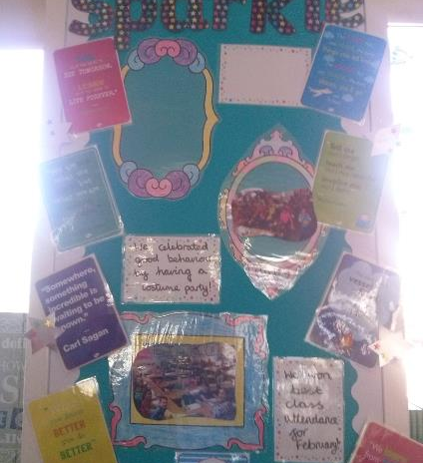
PRIMARY SCHOOL
Highbury Primary School, Nursery And Day Care

Slide 32
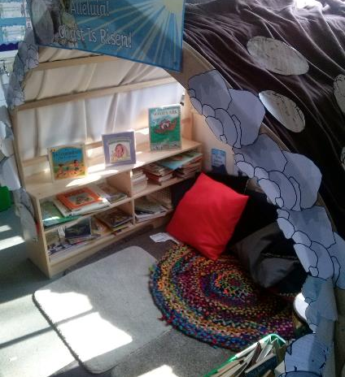
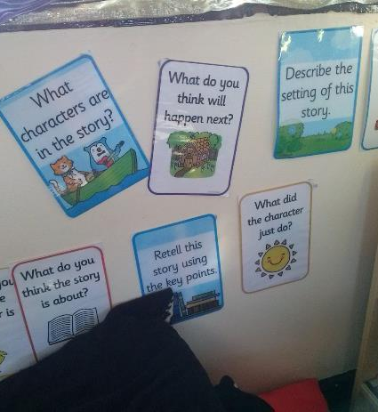
PRIMARY SCHOOL
Highbury Primary School, Nursery And Day Care

Slide 33
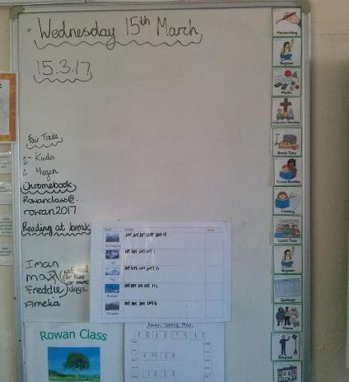
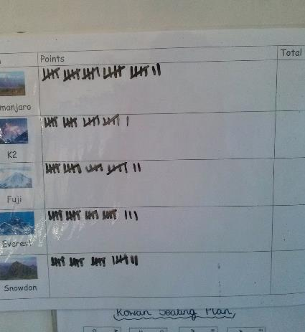
PRIMARY SCHOOL
Highbury Primary School, Nursery And Day Care

Slide 34
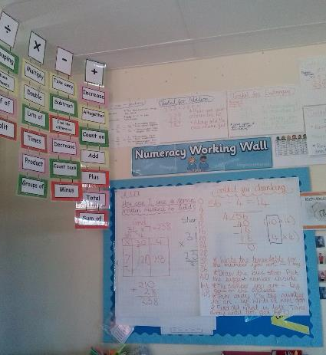
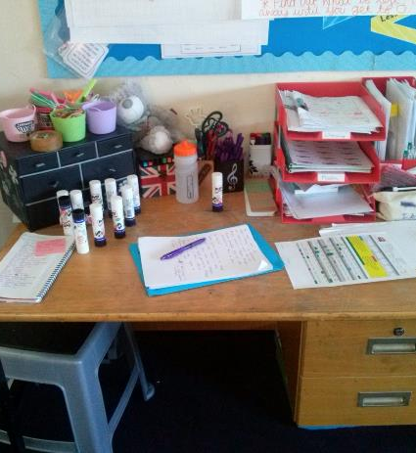
PRIMARY SCHOOL
Highbury Primary School, Nursery And Day Care

Slide 35
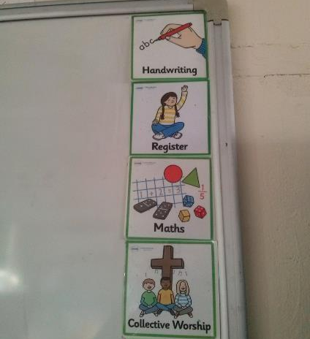
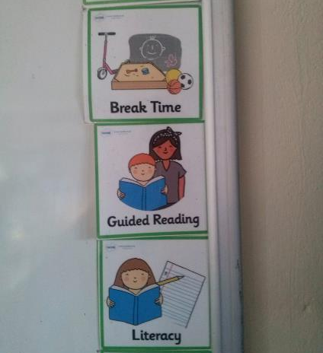
PRIMARY SCHOOL
Highbury Primary School, Nursery And Day Care

Slide 36
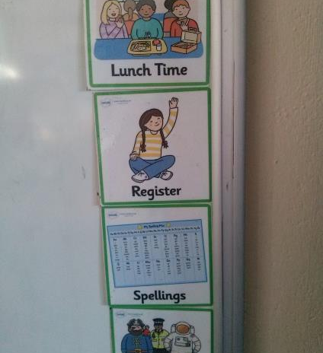
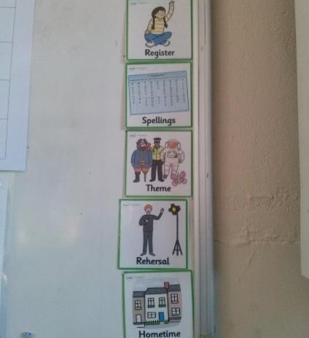
PRIMARY SCHOOL
Highbury Primary School, Nursery And Day Care

Slide 37
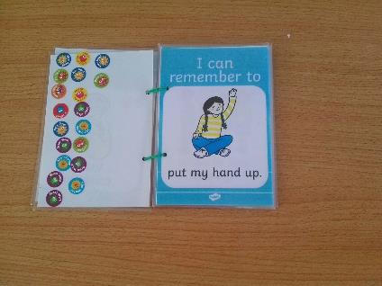
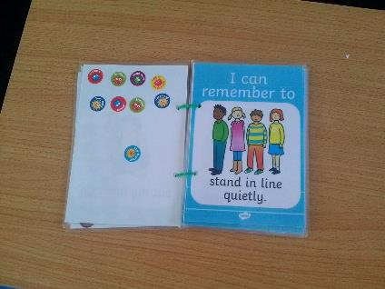
PrimaPRIMARY SCHOOL
Highbury Primary School, Nursery And Day Carery school

Slide 38
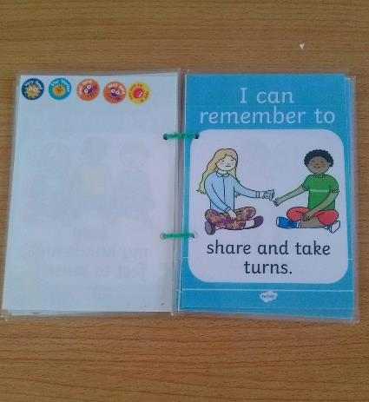
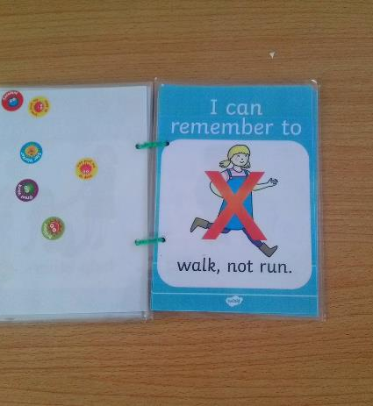
PRIMARY SCHOOL
Highbury Primary School, Nursery And Day Care

Slide 39


PRIMARY SCHOOL
Highbury Primary School, Nursery And Day Care

Slide 40


Slide 41

Primary school
Arundel Court Primary

Slide 42

Primary school
Arundel Court Primary

Slide 43

Primary school
Arundel Court Primary

Slide 44

Primary school
Arundel Court Primary

Slide 45


Primary school
Arundel Court Primary

Slide 46


Primary school
Arundel Court Primary

Slide 47


Primary school
Arundel Court Primary

Slide 48

Primary school
Arundel Court Primary

Slide 49


Primary school
Arundel Court Primary

Slide 50


Primary school
Arundel Court Primary

Slide 51

Primary school
Arundel Court Primary

Slide 52


Primary school
Arundel Court Primary

Slide 53


Primary school
Arundel Court Primary

Slide 54


Primary school
Arundel Court Primary

Slide 55


Primary school
Arundel Court Primary

Slide 56

Primary school
Arundel Court Primary

Slide 57

Primary school
Arundel Court Primary

Slide 58

Primary school
Arundel Court Primary

Slide 59

Primary school
Arundel Court Primary

Slide 60

Primary school
Arundel Court Primary

Slide 61

Primary school
Arundel Court Primary

